Slide 1
CS Students' Brief on CSS
Essential CSS for CS3172
Notes:
Dalhousie CSCI 3172
Lecture: CSS Essentials
Fall 2007–2008 version

Slide 2
Background
Presentation vs. Structure
  An early goal of the WWW
  Easy to update many pages at once
  Easier to maintain consistency
Early goal: authors' vs. readers' rules
  Now partly respected by major browsers
CSS 1 ⎝ CSS 2
  Extended the scope of the rules
Notes:
Dalhousie CSCI 3172
Lecture: CSS Essentials
Fall 2007–2008 version

Slide 3
CS Student Overview of CSS
Ignoring most of the incompatibilities for now
  To get an overall understanding
  Later slides will show some details
We'll examine 4 interesting parts of the presentational instructions and options later
But first we'll see
  What it can do (CSS Zen Garden,CSS Examples)
  & How it works
Colour | Font | Border | Position
Notes:
Dalhousie CSCI 3172
Lecture: CSS Essentials
Fall 2007–2008 version

Slide 4
What's Next?
Introduction to CSS rule method
CSS selectors
How CSS matches rules to elements
  The parse tree
  The cascade
How to include rules in an XHTML file
  A simple example
Visual formatting and Dual presentation
Notes:
Dalhousie CSCI 3172
Lecture: CSS Essentials
Fall 2007–2008 version

Slide 5
How CSS Works — Rules
Rules provide presentation hints to browser
  Browser can ignore hints
  Three sources of rules:
    User agent (browser's default settings),
    Webpage (source file),
    The user (personal settings in the browser)
Rules apply when selectors match context
  E.g. p {text-indent:1.5em }
  Selector is p (matches any <p> element)
Notes:
Dalhousie CSCI 3172
Lecture: CSS Essentials
Fall 2007–2008 version

Slide 6
Rules
Attached to elements
  As attributes of elements (inline style)
  Tied to id attribute of elements
  Tied to class attribute of elements
Rules all have form
  {Property Name : Value;}
Multiple rules separated by ;
Notes:
Dalhousie CSCI 3172
Lecture: CSS Essentials
Fall 2007–2008 version

Slide 7
Selectors
Can apply to every element of a type
  E.g. h2
More often to a class of element
  <cite class="textbook book">
  Matches both textbook and book
Can apply to pseudo-elements
  a:visited, etc.
Notes:
Dalhousie CSCI 3172
Lecture: CSS Essentials
Fall 2007–2008 version

Slide 8
Special Elements
div and span
  Only for grouping other elements
  div is block-level (think about paragraphs)
  span is in-line (think about <code>)
Notes:
Dalhousie CSCI 3172
Lecture: CSS Essentials
Fall 2007–2008 version

Slide 9
Selectors (cont.)
E
E₁ E₂
E₁ > E₂
E₁ + E₂
E#id
E.class
See the handout for more pattern matches
Resources about selectors are listed on a later slide (just after the cascade)
The selector always refers to the rightmost element
Notes:
Dalhousie CSCI 3172
Lecture: CSS Essentials
Fall 2007–2008 version

Slide 10
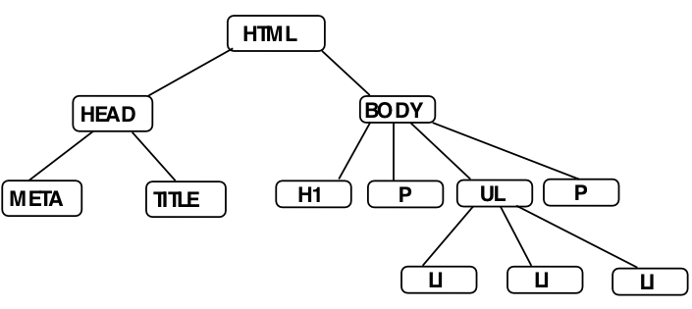
How CSS Works — Matching
Every XHTML document represents a document tree
The browser uses the tree to determine which rules apply
What about inheritance? And conflicts?
Notes:
Dalhousie CSCI 3172
Lecture: CSS Essentials
Fall 2007–2008 version

Slide 11
Notes:
Dalhousie CSCI 3172
Lecture: CSS Essentials
Fall 2007–2008 version

Slide 12
HTML Parse Tree
<html>
  <head>
    <meta … />
    <title>…</title>
  </head>
  <body>
    <h1>…</h1>
    <p>…</p>
    <ul>
      <li>…</li>
      <li>…</li>
      <li>…</li>
    </ul>
    <p>…</p>
  </body>
</html>
Notes:
Dalhousie CSCI 3172
Lecture: CSS Essentials
Fall 2007–2008 version

Slide 13
HTML Parse Tree
<html>
  <head>
    <meta … />
    <title>…</title>
  </head>
  <body>
    <h1>…</h1>
    <p>…<span>…</span>…</p>
    <ul>
      <li>…</li>
      <li>…</li>
      <li>…<span>…</span>…</li>
    </ul>
    <p>…</p>
  </body>
</html>
What will h1 + p match?
What will ul > span match?
What will ul {color:blue} do?
Notes:
Dalhousie CSCI 3172
Lecture: CSS Essentials
Fall 2007–2008 version

Slide 14
Inheritance in CSS
⎠ The Cascade
Inheritance moves down tree
Cascading move horizontally
  It works on elements that the same rules apply to
  It is only used for tie-breaking when ≥2 rules apply
The highest ranking rule wins
Most specific wins (usually)
But important rules override others
  !important beats plain
  User's !important beats everything else
Notes:
Dalhousie CSCI 3172
Lecture: CSS Essentials
Fall 2007–2008 version

Slide 15
Details of the CSS 2.1 Cascade
For each element E
  Find all declarations that apply to E
  Rank those declarations by origin
    user !important > author !important > inline style
    inline style > author plain > user plain > browser
  If there is not a clear winner then most specific rule wins.
    Compute specificity as shown on next 2 slides.
Notes:
Dalhousie CSCI 3172
Lecture: CSS Essentials
Fall 2007–2008 version

Slide 16
CSS 2.1 Cascade (Continued)
Compute specificity thus:
  If one rule uses more # symbols than the others then it applies, otherwise …
  If one rule uses more attributes (including class) than the others then it applies, otherwise …
  If one rule uses more elements then it applies
  For each two rules that have the same number of every one of the above specifiers, the one that was declared last applies
class is the only attribute that can be selected with the . in CSS
An equivalent method is shown on the next slide
Notes:
Dalhousie CSCI 3172
Lecture: CSS Essentials
Fall 2007–2008 version

Slide 17
CSS 2.1 Cascade Computation
The cascade algorithm in the standard uses a semi-numerical algorithm
The computation looks like this:
The specificity is a×base³ + b×base² + c×base + d
  Where base = 1 + maximum(b,c,d)
  The rule with the largest specificity applies
class is an attribute
 |  | 1 if the selector is an inline style
a =
 |  | 0 otherwise
b = |  | Number of id attributes (but only if specified with #)
c = |  | Number of attributes (except those in b) and pseudo-attributes specified
d = |  | Number of non-id elements specified (including pseudo-elements)
Notes:
Dalhousie CSCI 3172
Lecture: CSS Essentials
Fall 2007–2008 version

Slide 18
CSS2 Cascade: Summary
To find the value for an element/property combination, user agents must apply the following sorting order:
  Find all declarations that apply to the element and property in question, for the target media type. Declarations apply if the associated selector matches the element in question.
  The primary sort of the declarations is by weight and origin: for normal declarations, author style sheets override user style sheets which override the default style sheet. For ‘!important’ declarations, user style sheets override author style sheets which override the default style sheet. ‘!important’ declaration override normal declarations. An imported style sheet has the same origin as the style sheet that imported it.
  The secondary sort is by specificity of selector: more specific selectors will override more general ones. Pseudo-elements and pseudo-classes are counted as normal elements and classes, respectively.
  Finally, sort by order specified: if two rules have the same weight, origin and specificity, the latter specified wins. Rules in imported style sheets are considered to be before any rules in the style sheet itself.
CSS2 Specification
§6.4.1 Cascading order
Notes:
Dalhousie CSCI 3172
Lecture: CSS Essentials
Fall 2007–2008 version
Cascading Style Sheets, level 2: CSS2 Specification
W3C Recommendation 12-May-1998
Editors:
Bert Bos, Håkon Wium Lie, Chris Lilley, & Ian Jacobs
<URL:http://www.w3.org/TR/1998/REC-CSS2-19980512>

Slide 19

To find the value for an element/property combination, user agents must apply the following sorting order:
  Find all declarations that apply to the element and property in question, for the target media type. Declarations apply if the associated selector matches the element in question.
  Sort according to importance (normal or important) and origin (author, user, or user agent). In ascending order of precedence:
    user agent declarations
    user normal declarations
    author normal declarations
    author important declarations
    user important declarations
  Sort rules with the same importance and origin by specificity of selector: more specific selectors will override more general ones. Pseudo-elements and pseudo-classes are counted as normal elements and classes, respectively.
  Finally, sort by order specified: if two declarations have the same weight, origin and specificity, the latter specified wins. Declarations in imported style sheets are considered to be before any declarations in the style sheet itself.
Apart from the ‘!important’ setting on individual declarations, this strategy gives author's style sheets higher weight than those of the reader. User agents must give the user the ability to turn off the influence of specific author style sheets, e.g., through a pull-down menu.
CSS 2.1 Cascade: Summary
CSS 2.1
§6.4.1 Cascading order
Notes:
Dalhousie CSCI 3172
Lecture: CSS Essentials
Fall 2007–2008 version
Cascading Style Sheets Level 2 Revision 1 (CSS 2.1) Specification
W3C Candidate Recommendation 19 July 2007
Editors:
Bert Bos, Tantek Çelik, Ian Hickson, & Håkon Wium Lie
<URL:http://www.w3.org/TR/CSS21/cascade.html#cascading-order>

Slide 20
Pseudo-Elements?
Pseudo-Attributes?!
‘CSS introduces the concepts of pseudo-elements and pseudo-classes to permit formatting based on information that lies outside the document tree.’
Classes
  :first-child
  :link,
  :visited
  :hover,
  :active,
  :focus
  :lang
Elements
  :first-line
  :first-letter
  :before,
  :after
CSS 2.1 §5.10
Pseudo-elements
and pseudo-classes
Notes:
Dalhousie CSCI 3172
Lecture: CSS Essentials
Fall 2007–2008 version

Slide 21
Selector Resources on the WWW
The CSS 2 Standard
  At W3.org (http://www.w3.org/TR/REC-CSS2/)
  In frames (http://www.meyerweb.com/eric/css/references/css2ref.html)
Selector Tutorial [Excellent!] (http://css.maxdesign.com.au/selectutorial/)
SelectORACLE (http://gallery.theopalgroup.com/selectoracle/)
Other Recommended Resources
  In the resources part of the course website
Notes:
Dalhousie CSCI 3172
Lecture: CSS Essentials
Fall 2007–2008 version

Slide 22
How To Include Rules
Inline
  <p style=“text-align: center” >…</p>
Inside the head element
  <link rel="stylesheet" type="text/css" href="site.css" />
  <style type="text/css">…</style>
  <style type="text/css">
    @import url(site.css);
    /* other rules could go here */
    </style>
Notes:
Dalhousie CSCI 3172
Lecture: CSS Essentials
Fall 2007–2008 version

Slide 23
Simple Example
Fonts and background colours
Inheritance and cascading
  See simple in CSS examples
Notes:
Dalhousie CSCI 3172
Lecture: CSS Essentials
Fall 2007–2008 version

Slide 24
A Very Brief Overview of
Visual Formatting With CSS
Visual Formatting
  Fonts
  Colours
  Position
  Box model and Borders
Dual presentation / Hiding CSS
Notes:
Dalhousie CSCI 3172
Lecture: CSS Essentials
Fall 2007–2008 version

Slide 25
Visual Formatting: fonts
Some major properties
  font-family
    body {font-family: Garamond, Times, serif}
    Serif fonts and sans-serif fonts
  font-size:
    Length (em,ex), percentage, relative size, absolute size
  font-style:
    Normal, italic, oblique
  font-weight:
    Lighter, normal, bold, bolder, 100, 200, …, 800, 900
Set all at once with font
Notes:
Dalhousie CSCI 3172
Lecture: CSS Essentials
Fall 2007–2008 version

Slide 26
Visual Formatting: Colours
How to specify
  16 Predefined names
  RGB values (%, #, 0…255)
  System names: e.g. CaptionText
Dithered Colour
  See Lynda Weinman's charts
  Okay for photos, etc.
Notes:
Dalhousie CSCI 3172
Lecture: CSS Essentials
Fall 2007–2008 version

Slide 27
Visual Formatting: Colours (cont.)
Major properties
  background-color
  color
transparent and inherit values
Notes:
Dalhousie CSCI 3172
Lecture: CSS Essentials
Fall 2007–2008 version

Slide 28
Visual Formatting: Images
position:
  static, relative, absolute, fixed
Static — normal elements
Relative — translate from usual position
Absolute — scroll with the page
Fixed — like absolute, but don't scroll away
Example: Jon Gunderson
Notes:
Dalhousie CSCI 3172
Lecture: CSS Essentials
Fall 2007–2008 version

Slide 29
Visual Formatting: Images (cont.)
z-index: depth
float and clear
  float: left or float: right or float: none
    Position relative to parent element
  Reset with clear
    <br style="clear:both" />
Notes:
Dalhousie CSCI 3172
Lecture: CSS Essentials
Fall 2007–2008 version

Slide 30
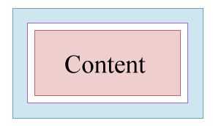
Visual Formatting: Box Model
Margin
Border
Padding
Figure from materials © by Dietel, Dietel, and Nieto
Notes:
Dalhousie CSCI 3172
Lecture: CSS Essentials
Fall 2007–2008 version
From slides to accompany Internet & World Wide Web: How to Program by Dietel, et al. published by Prentice-Hall in 2000.

Slide 31
Borders? Do we have borders!
Four types again
Can all be set at once with border
See Border slides by Jon Gunderson
Notes:
Dalhousie CSCI 3172
Lecture: CSS Essentials
Fall 2007–2008 version

Slide 32

Box Model (Cont.)
Padding
  Size in %, em, or ex for text
  padding-top, padding-right, padding-bottom, padding-left
    Mnemonic: TRouBLe
  Set all at once with padding
Margin
  Similar to padding
  But can also be auto
    see centring example
Width is of content only.
Neither the border nor the
padding are included in width.
Notes:
Dalhousie CSCI 3172
Lecture: CSS Essentials
Fall 2007–2008 version

Slide 33
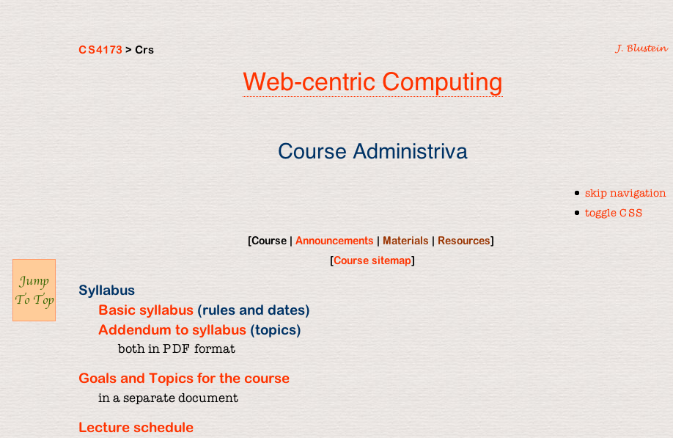
Making Room for a fixed position object
body
{margin-left: 6.3em}
div.up
{position: fixed;
left: 1em;
top: 40%;
padding: .2ex;
min-width: 5.5ex }
Width computation: see <URL: http://tantek.com/CSS/Examples/boxmodelhack.html>
Notes:
Dalhousie CSCI 3172
Lecture: CSS Essentials
Fall 2007–2008 version

Slide 34
Formatting The ‘Jump Box’
‘Jump Box’
Notes:
Dalhousie CSCI 3172
Lecture: CSS Essentials
Fall 2007–2008 version

Slide 35
Basic Formatting of the
‘Jump Box’
HTML Outline
<body>
  <!-- … -->
  <div class="up">
    <dl>
      <dt>Jump to top</dt>
    <!-- … -->
  </div>
</body>
Extract of CSS Rules
body
  {margin-left: 6.3em}
div.up
  {position: fixed;
  left: 1em;
  top: 40%;
  padding: .2ex;
  min-width: 5.5ex }
Notes:
Dalhousie CSCI 3172
Lecture: CSS Essentials
Fall 2007–2008 version

Slide 36
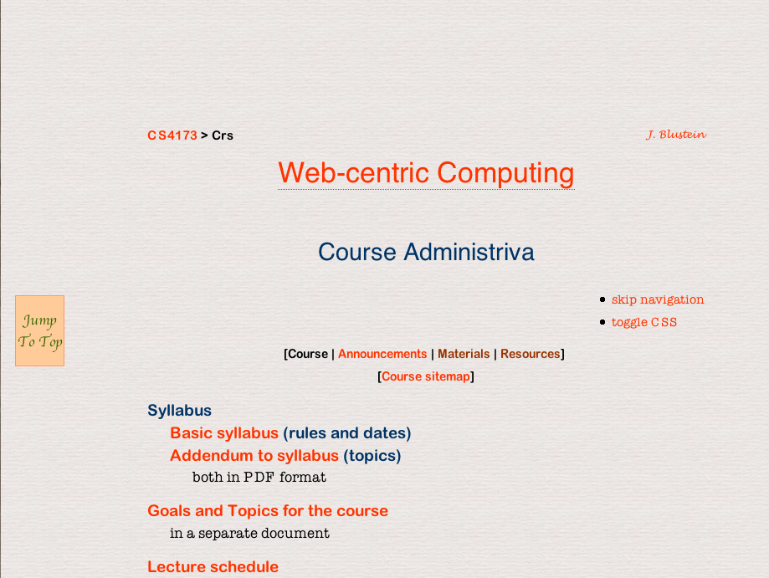
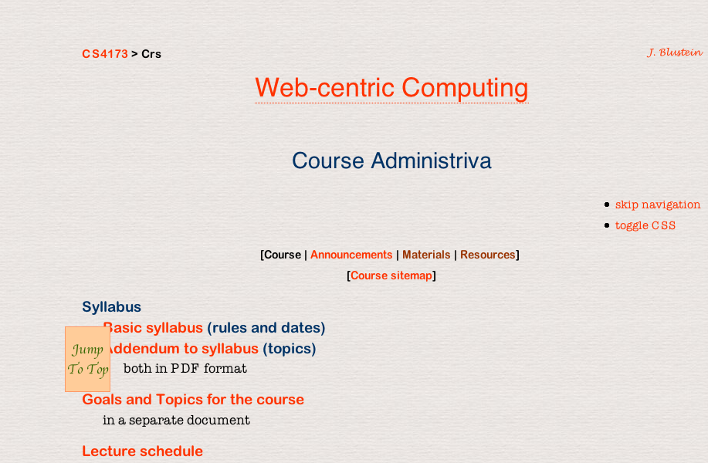
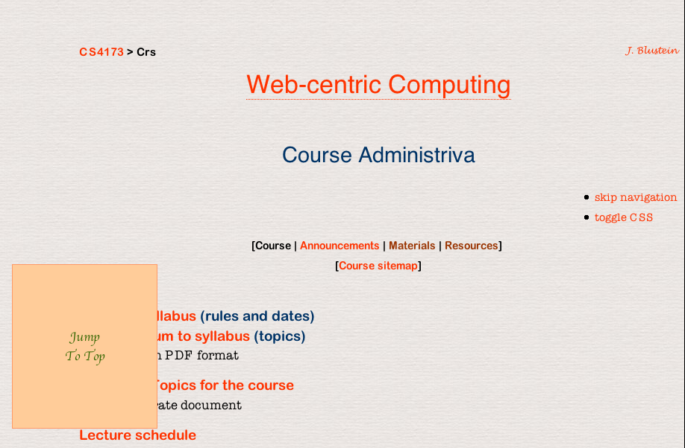
Effects of Box Formatting
Notes:
Dalhousie CSCI 3172
Lecture: CSS Essentials
Fall 2007–2008 version

Slide 37
body {padding:4em}
Notes:
Dalhousie CSCI 3172
Lecture: CSS Essentials
Fall 2007–2008 version

Slide 38
div.up {margin: 4em}
Notes:
Dalhousie CSCI 3172
Lecture: CSS Essentials
Fall 2007–2008 version

Slide 39
div.up dl {margin:4em}
Notes:
Dalhousie CSCI 3172
Lecture: CSS Essentials
Fall 2007–2008 version

Slide 40
CSS For Dual Presentation
What if users don't have CSS?
  See button example
What if CSS only sortof works?
  Tricks to hide CSS from dumb browsers
How can I make cool webpages?
  One of many ways: see W3C Core Styles
Notes:
Dalhousie CSCI 3172
Lecture: CSS Essentials
Fall 2007–2008 version

Slide 41
Hiding CSS —
Why do we need to?
Two failure modes: graceful and catastrophic
Pragmatism
Hubris
Notes:
Dalhousie CSCI 3172
Lecture: CSS Essentials
Fall 2007–2008 version

Slide 42
A Trick For Dual Presentation
visibility:
  visible or hidden
display:
  none
visibility example (CSS buttons)
visible:hidden
element can't be seen
but it still uses space
display:none
element isn't shown
Notes:
Dalhousie CSCI 3172
Lecture: CSS Essentials
Fall 2007–2008 version

Slide 43
Hiding CSS — How (overview)
Ensure that markup is meaningful without CSS
  Order of presentation
  Extra/hidden content
Make styles in layers
  v4.0 browsers don’t recognize @import
  Some browsers ignore media rules
  Later, and more specific, rules override other rules
Use parsing bugs for browser detection
  Example follows
Use browser-specific Javascript
Server-side detection doesn’t work well
  Too much spoofing
Notes:
Dalhousie CSCI 3172
Lecture: CSS Essentials
Fall 2007–2008 version

Slide 44
Hiding CSS — Some details
Credits follow
IE 5 for Windows computes incorrect sizes
It also doesn’t understand voice-family, so…
p {
font-size: x-small; /* for Win IE 4/5 only */
voice-family: "\"}\"";
/* IE thinks rule is over */
voice-family: inherit; /* recover from trick */
font-size: small /* for better browsers */
}
html>p {font-size: small} /* for Opera */
Notes:
Dalhousie CSCI 3172
Lecture: CSS Essentials
Fall 2007–2008 version

Slide 45
Hiding CSS — Caveats
There are no fool-proof workarounds for every bug in every browser
Some workarounds are incompatible with strict XHTML
The workarounds take time and are sometimes inelegant
But they are necessary if you want to reach the largest possible audience
For more about hacks see <URL:http://tantek.com/log/2005/11.html>
Notes:
Dalhousie CSCI 3172
Lecture: CSS Essentials
Fall 2007–2008 version

Slide 46
Hiding CSS — Credits
The example was adapted from
  p. 324 of Designing with web standards by Jeffrey Zeldman (©2003 by the author, published by New Riders with ISBN 0-7357-1201-8)
The methods are due to
  Tantek Çelick (who also created much of Mac IE and much else)
Notes:
Dalhousie CSCI 3172
Lecture: CSS Essentials
Fall 2007–2008 version

